Slide 1

CENG 789 – Digital Geometry Processing
11- Mesh Deformation
Assoc. Prof. Yusuf Sahillioğlu
Computer Eng. Dept, , Turkey

Slide 2
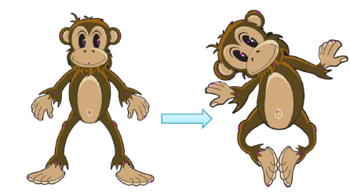
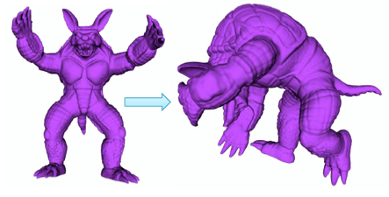
Goal
<number> / 114
Find the new vertex coordinates for a plausible manipulation/motion.

Slide 3

Goal
<number> / 114
Complex math hidden behind an intuitive user interface.

Slide 4
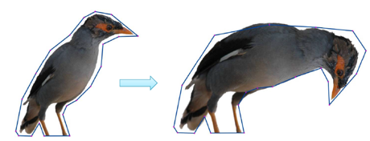
Motivation
<number> / 114
Provides easy modeling; i.e., generate new shapes by deforming existing ones.
  Create a basketball that deforms when bounced.
  Deform Toy Story characters as they walk, talk, been hit, etc.

Slide 5
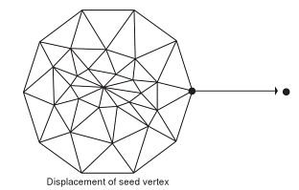
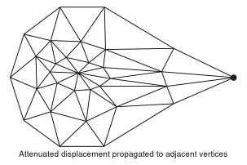
Deformation Types
<number> / 114
Vertex-by-vertex displacement is easy but tedious ☹.
Group a number of vertices and displace them uniformly is easy but too restrictive ☹.
Allow user to displace 1+ seed/handle vertex and propagate the displacement to close vertices while attenuating the amount of displacement ☺.

Slide 6
Deformation Types
<number> / 114
Attenuation functions:
  Trade off quality vs. computational complexity.
  Euclidean distance.
  Min # of edges connecting seed to the vertex to be displaced.
  Geodesic distance.

Slide 7

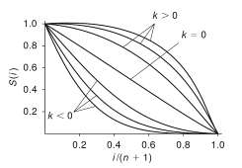
Deformation Types
<number> / 114
Attenuation functions:
  Min # of edges connecting seed to the vertex to be displaced.
  User specifies max range of effect to be verts within n edges of seed.
  k=0 makes linear attenuation.
  k<0 elastic, k>0 rigid displacements.

Slide 8
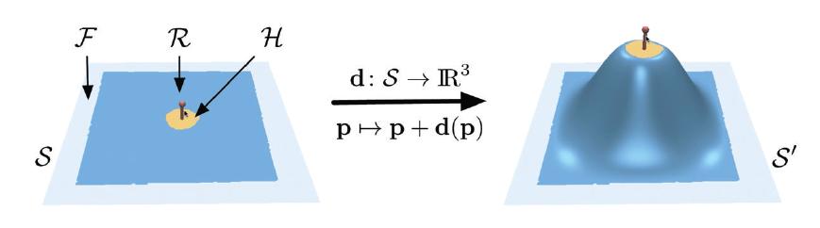
Deformation Types
<number> / 114
User controls the deformation by moving a handle region H and keeping the region F fixed. The unconstrained deformation region R should deform in an intuitive manner.

Slide 9
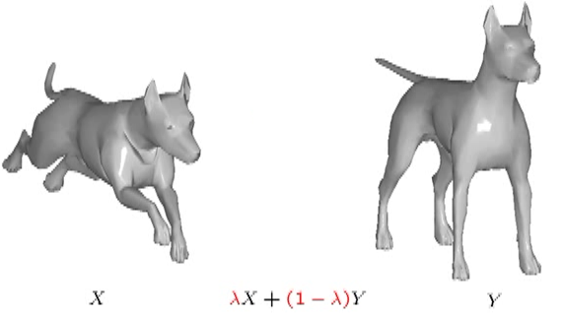
Deformation Types
<number> / 114
Creating the in-betweens in shape interpolation is also a deformation.

Slide 10
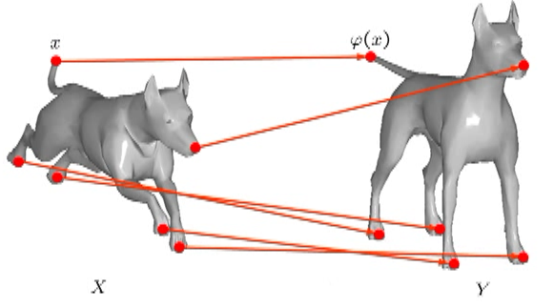
Deformation Types
<number> / 114
Creating the in-betweens in shape interpolation is also a deformation.

Slide 11
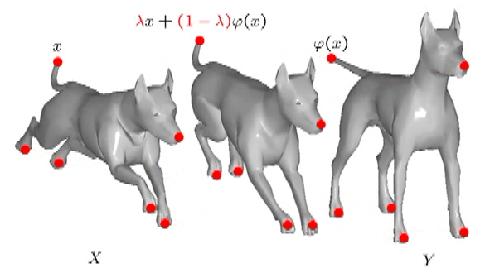
Deformation Types
<number> / 114
Creating the in-betweens in shape interpolation is also a deformation.

Slide 12
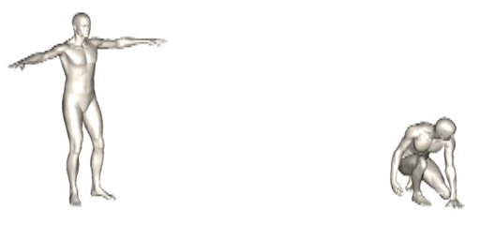
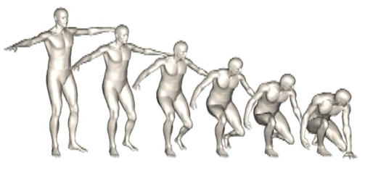
Deformation Types
<number> / 114
Creating the in-betweens in shape interpolation is also a deformation.
No problem:

Slide 13
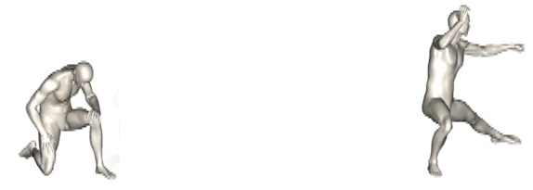
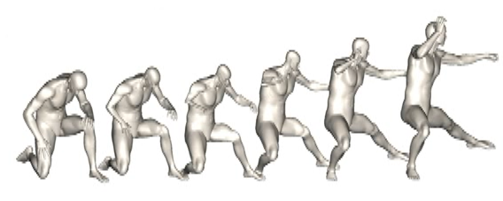
Deformation Types
<number> / 114
Creating the in-betweens in shape interpolation is also a deformation.
Problem at hands:

Slide 14
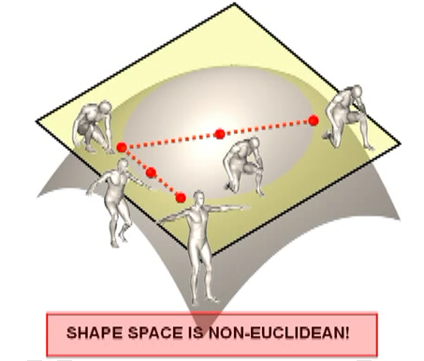
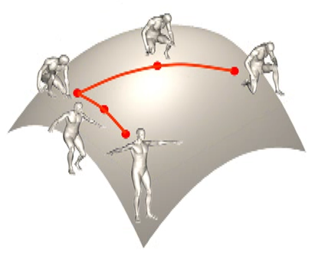
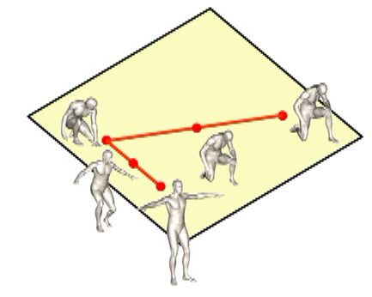
Deformation Types
<number> / 114
Creating the in-betweens in shape interpolation is also a deformation.
Reason: shape space is not linear, e.g., distance b/w 2 shapes nonliner

Slide 15
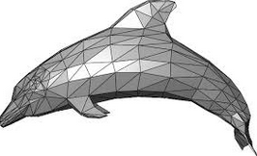
Deformation Types
<number> / 114
Shell-based deformation: polygon meshes.
Volume-based deformation: tetrahedral meshes.
Multi-scale deformation: efficiency
Free-form deformation: lattice-based and cage-based.

Slide 16
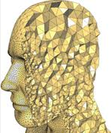
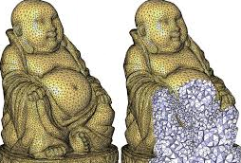
Volume-based Deformation
<number> / 114
Shell-based deformation: polygon meshes.
Volume-based deformation: tetrahedral meshes.
Multi-scale deformation: efficiency.
Free-form deformation: lattice-based and cage-based.

Slide 17
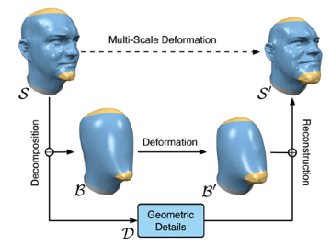
Multi-Scale Deformation
<number> / 114
Shell-based deformation: polygon meshes.
Volume-based deformation: tetrahedral meshes.
Multi-scale deformation: efficiency
Free-form deformation: lattice-based and cage-based.
Notes:
General multi-scale editing framework consists of three main operators: the decomposition operator, which separates the low and high frequencies; the editing operator, which deforms the low frequency components; and the reconstruction operator, which adds the details back onto the modified base surface.

Slide 18
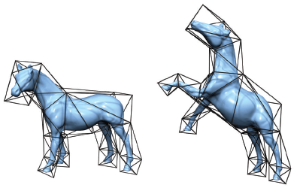
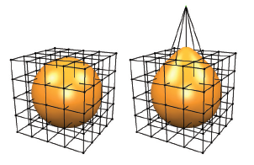
Free-Form Deformation (FFD)
<number> / 114
Shell-based deformation: polygon meshes.
Volume-based deformation: tetrahedral meshes.
Multi-scale deformation: efficiency
Free-form deformation: lattice-based or cage-based.
Notes:
Cool demo: https://www.youtube.com/watch?v=Bhilhg0rQtY

Slide 19
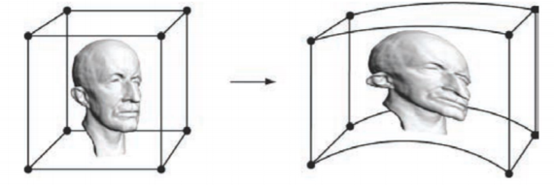
FFD
<number> / 114
Free-form deformation: lattice-based or cage-based.
Deform the ambient space (grid/cage), and thus implicitly deform the embedded objects.
For each vertex of the object, coordinates relative to local grid are determined that register the vertex to the grid.
Low-reso grid is then manipulated by the user.
Using its relative coords, each vertex is mapped back to modified grid, which relocates the vertex in global space.
Parallel execution is possible since each cell is independent.

Slide 20
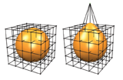

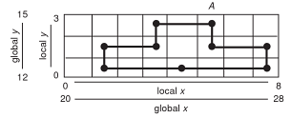
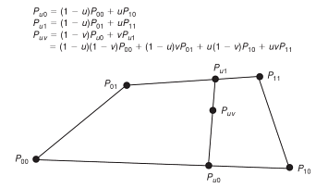
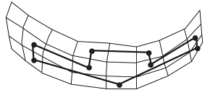
FFD
<number> / 114
Free-form deformation: lattice-based or cage-based.
Vertex A has global coordinates of (25.6, 14.7), local coordinates of (5.6, 2.7).
Vertex A (and others) are relocated in the modified grid by bilinear interpolation relative to the containing cell of the grid: interpolants u&v=.6 & .7

Slide 21
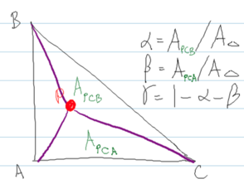
FFD
<number> / 114
Free-form deformation: lattice-based or cage-based.
Other grid cells also possible: triangle cells.
Barycentric Coordinates: any point P
in a triangle can be expressed as:
P = alpha A + beta B + gamma C
Idea: If we move any of the triangle’s vertices or if we apply any transformation to the triangle, we can use the Barycentric Coordinates of any point on the original triangle to compute their corresponding position on the new triangle.

Slide 22
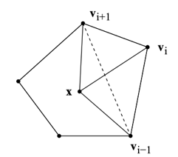
FFD
<number> / 114
Free-form deformation: lattice-based or cage-based.
Other grid cells also possible: convex polygon cells.
Wachspress Coordinates: any point x
in a convex polygon can be expressed.
Idea: If we move any of the polygon’s vertices or if we apply any transformation to the polygon, we can use the Wachspress Coordinates of any point on the original polygon to compute their corresponding position on the new polygon.

Slide 23
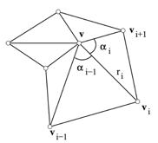

FFD
<number> / 114
Free-form deformation: lattice-based or cage-based.
Other grid cells also possible: arbitrary polygon cells.
Mean Value Coordinates: any point v
in any polygon can be expressed.
Idea: If we move any of the polygon’s vertices or if we apply any transformation to the polygon, we can use the Mean Value Coordinates of any point on the original polygon to compute their corresponding position on the new polygon.

Slide 24
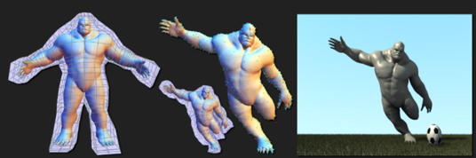
FFD
<number> / 114
Free-form deformation: lattice-based or cage-based.
Other grid cells also possible: arbitrary polyhedron cells.
3D Mean Value Coordinates: any point
in any polyhedron can be expressed.
Idea: If we move any of the polyhedron’s vertices or if we apply any transformation to the polyhedron, we can use the 3D Mean Value Coordinates of any point on the original polyhedron to compute their correspondng position on new polyhedron.

Slide 25
FFD
<number> / 114
Free-form deformation: lattice-based or cage-based.
Cool sources for details on Barycentric, Wach, Mean Value Coordinates.
  http://cgvr.cs.uni-bremen.de/teaching/cg_literatur/barycentric_floater.pdf
  https://www.mn.uio.no/math/english/people/aca/michaelf/papers/wach_mv.pdf
  http://folk.uio.no/martinre/Publications/mv3d.pdf
  https://www.youtube.com/watch?v=PDJxjXCjiis
  http://hecodes.com/2016/07/mesh-manipulation-using-mean-values-coordinates-in-three-js/

Slide 26

Interpolation
<number> / 114
FFD is all about interpolation. Let’s see some interpolation types.
Linear interpolation: interpolation over a 1D line.
  Find the value of f at point x: f(x)
Bilinear interpolation: interpolation over a 2D plane.
    Find the value of f at point (x, y): f(x, y)
Trilinear interpolation: interpolation over a 3D volume.
      Find the value of f at point (x, y, z): f(x, y, z)

Slide 27
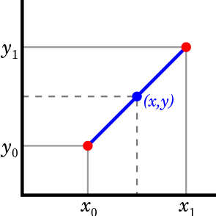

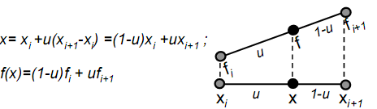
Interpolation
<number> / 114
Linear interpolation: interpolation over a 1D line.
Interpolate points (or other attributes) on a line from v₀ to v₁ using t.

Slide 28
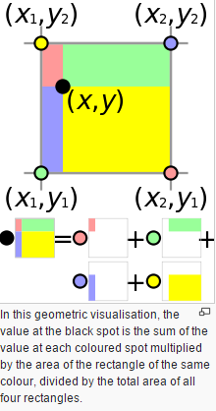
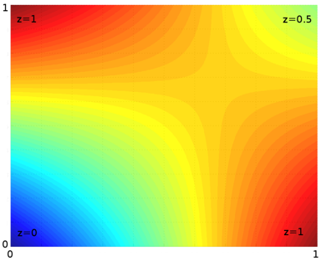
Interpolation
<number> / 114
Bilinear interpolation: interpolation over a 2D plane.
Interpolate .. using u and v.

Slide 29
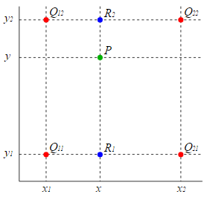
Interpolation
<number> / 114
Bilinear interpolation: interpolation over a 2D plane.
Interpolate .. using u and v.
more formally, we do lerp in 1 direction, and then again in the other direction.
do lerp to find R1, then R2. Then do lerp using R1, R2; get P.

Slide 30
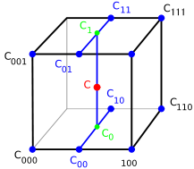
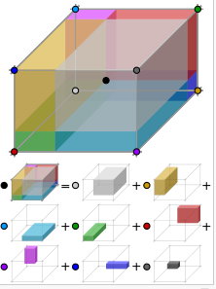
Interpolation
<number> / 114
Trilinear interpolation: interpolation over a 3D cell.
Interpolate .. using u, v, and w.
More formally, lerp of 2 bilerps (one for the bottom face, one for top).
u and v for the bilerps, w for the final lerp.
FFD in 3D employs trilinear interpolation:

Slide 31
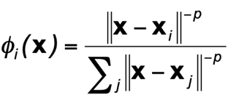

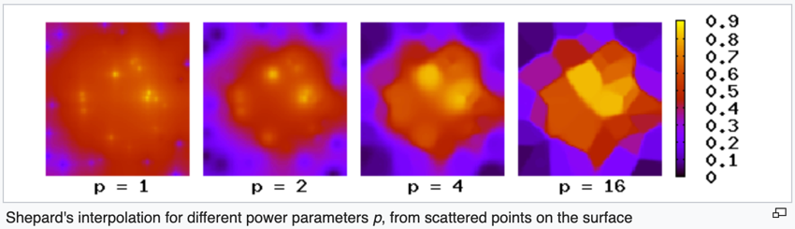
Interpolation
<number> / 114
Interpolation without cells, i.e., scattered data interpolation, can be done via Shepard interpolation (1968); inverse distance weighting.
x_{i} : scattered points, f_{i} : function values at scattered points.
Neighborhood not given explicitly: specify in terms of radius, # points.

Slide 32
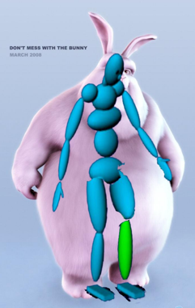
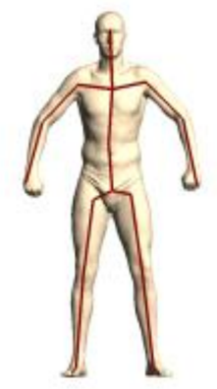
Skinning
<number> / 114
A variant of FFD is skinning/enveloping, where you put the control “cage” inside the shape, i.e., skeleton controls the surfce deformation.

Slide 33
Skinning
<number> / 114
A variant of FFD is skinning/enveloping, where you put the control “cage” inside the shape, i.e., skeleton controls the surfce deformation.
Bind skin vertices to bones.
Animate skeleton (easy: change the joint angles), skin'll move with it.
Skinning is aka
  Skeletal subspace deformation (SSD).
  Linear blend skinning (LBS).

Slide 34
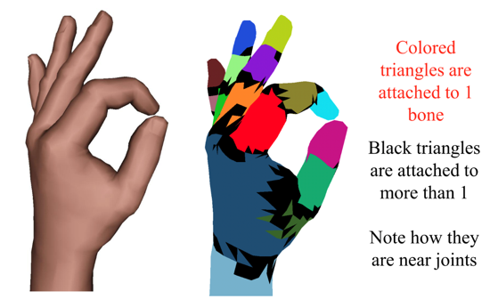
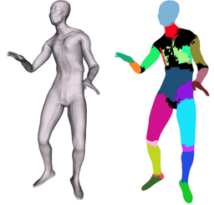
Skinning
<number> / 114
Skinning.

Slide 35
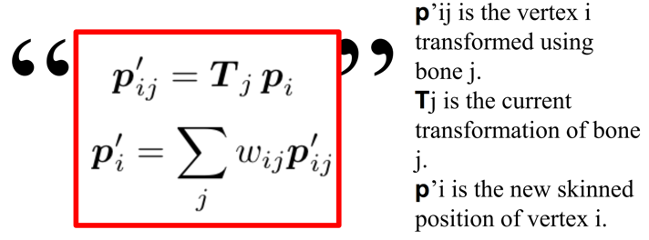

Skinning
<number> / 114
Skinning weights (manual or by using example poses & skins).
w_{ij}: how much surface vertex p_{i} moves with bone j (1 means rigid).
Some details involved: bind pose transformations B_{j} come in to express p_{i} in the local coordinate system of bone j. Only then T_{j} makes sense.

Slide 36
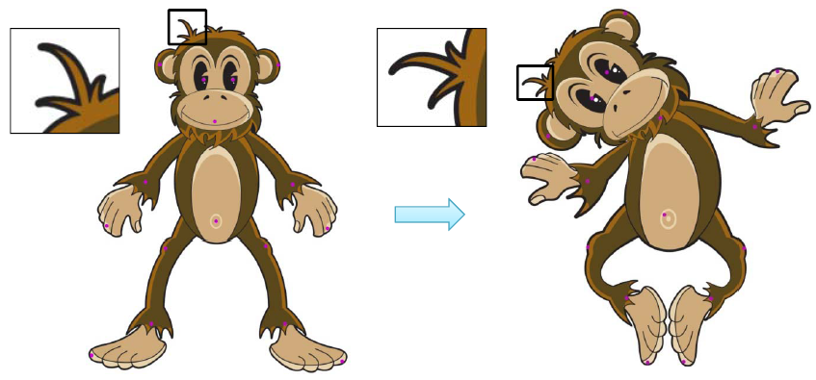
Shell-based Deformation
<number> / 114
Challenge: intuitive deformation requires global change + local detail preservation.

Slide 37
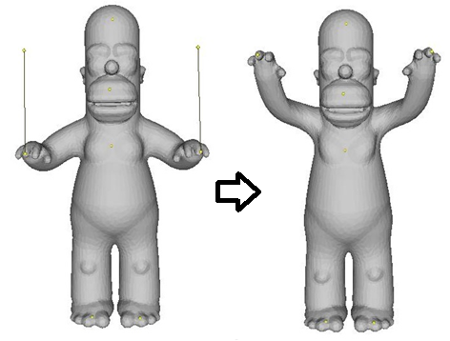
Shell-based Deformation
<number> / 114
Shell-based deformation using Laplacian coordinates
  Laplacian deformation, in short.
  Laplacian coordinates = differential coordinates = delta coordinates
Control mechanism
  Handles (vertices) moved by user.
  Region of influence (ROI) is
  deformed accordingly.

Slide 38
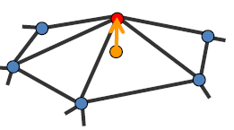


Differential Coordinates
<number> / 114
Difficult to do operations on meshes that store the geometry in Absolute Coordinates.
  Doing deformation that preserve overall shape is difficult operating on point-by-point basis.
A solution: Use Differential Coordinates.
  v.delta encapsulates local shape information around v.
  = approximation of mean curvature around v times the normal direction at v.
  weights=1
  (umbrella weighting)

Slide 39

Differential Coordinates
<number> / 114
Difficult to do operations on meshes that store the geometry in Absolute Coordinates.
  Doing deformation that preserve overall shape is difficult operating on point-by-point basis.
A solution: Use Differential Coordinates.
  v.delta encapsulates local shape information around v.
  = approximation of mean curvature around v times the normal direction at v.
  vector from center of
  1-ring neighbors to vi average those vectors

Slide 40
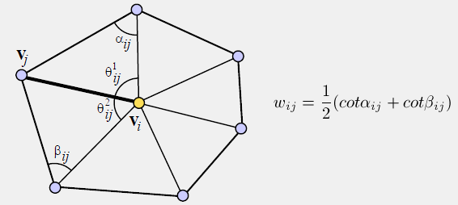
Differential Coordinates
<number> / 114
Differential Coordinates by cotangent weighting.
  A more geometry-aware weighting scheme than umbrella weighting.
  Invariant to different tessellations.
  Angle-based: preserves angles (and consequently areas) much better than umbrella wi = 1 weighting.

Slide 41

Differential Coordinates
<number> / 114
Differential Coordinates by cotangent weighting.
  Resulting deformation when umbrella (left) vs. cot (right) weighting in use:

Slide 42





Differential Coordinates (Parameterization)
<number> / 114
Cotangent weighting advantage can be seen better w/ parameterization.
  Copied from my Mesh Parameterization slides.
Didactic example: texture and mesh are and .
Pyramid’s (no floor) pole slightly moved so its projection not in center.
2D parameterization overlayed w/ texture (uniform, cotan, mean-val):

Slide 43

Differential Coordinates (uni. vs. cot.)
uni. cot.
<number> / 114
Cotangent weighting advantage can be seen better w/ parameterization.
  Copied from my Mesh Parameterization slides.
Didactic example: texture and mesh are and .
Pyramid’s (no floor) pole slightly moved so its projection not in center.
3D w/ pulled-back texture (birdeye view); note the distortion at the left.

Slide 44

Differential Coordinates (uni. vs. cot.)
uni. cot.
<number> / 114
Cotangent weighting advantage can be seen better w/ parameterization.
  Copied from my Mesh Parameterization slides.
Didactic example: texture and mesh are and .
Pyramid’s (no floor) pole slightly moved so its projection not in center.
Not so clear w/
non-birdeye view:

Slide 45


Differential Coordinates
<number> / 114
Differential Coordinates by Laplacian Matrix L.
  Since a differential coordinate is a linear combination of a vertex and its neighbors, the process of constructing differential coordinates for all vertices can be represented as a matrix L such that Lv = delta.

Slide 46


Differential Coordinates
<number> / 114
Differential Coordinates by Laplacian Matrix L.
  Since a differential coordinate is a linear combination of a vertex and its neighbors, the process of constructing differential coordinates for all vertices can be represented as a matrix L such that Lv = delta.
  Recall, .

Slide 47
Differential Coordinates
<number> / 114
Differential Coordinates by Laplacian Matrix L.
  NxN matrix L is extremely sparse: degree = 6 → (6+1) out of N non-zero entries per row where N is the number of vertices; typically N > 10000.
  Use a sparse matrix package: Eigen http://eigen.tuxfamily.org/index.php?title=Main_Page
  Eigen’ll also be handy while solving linear system Ax = b for the deformation.
  Useful for eigenanalysis too.
  In short, a cool linear algebra library.

Slide 48

Differential Coordinates (Surface Reconstruction)
<number> / 114
Recovering Absolute Coordinates from Differential Coordinates.
  delta stores differential coordinates, which throws away all info about Absolute positions → translation offset from origin is lost.
  To recover/put mesh somewhere in space, try some basic linear algebra:
  This trial fails ‘cos L is not full-rank → not invertible.

Slide 49

Differential Coordinates (Surface Reconstruction)
<number> / 114
Recovering Absolute Coordinates from Differential Coordinates.
  delta stores differential coordinates, which throws away all info about Absolute positions → translation offset from origin is lost.
  To recover/put mesh somewhere in space, specify the location of exactly 1 vertex (fixed).
    To do this, simply add one row to the bottom of the L matrix that has a 1 at the index of this fixed vertex and zeros everywhere else, and set the corresponding differential coordinate of this row to be the desired absolute position of that vertex.

Slide 50

Differential Coordinates (Surface Reconstruction)
<number> / 114
Recovering Absolute Coordinates from Differential Coordinates.
  delta stores differential coordinates, which throws away all info about Absolute positions → translation offset from origin is lost.
  To recover/put mesh somewhere in space, specify the location of exactly 1 vertex (fixed).
    To do this, simply add one row to the bottom of the L matrix that has a 1 at the index of this fixed vertex and zeros everywhere else, and set the corresponding differential coordinate of this row to be the desired absolute position of that vertex.

Slide 51



Differential Coordinates (Surface Reconstruction)
<number> / 114
Recovering Absolute Coordinates from Differential Coordinates.
  delta stores differential coordinates, which throws away all info about Absolute positions → translation offset from origin is lost.
  To recover/put mesh somewhere in space, specify the location of exactly 1 vertex (fixed).
    To do this, simply add one row to the bottom of the L matrix that has a 1 at the index of this fixed vertex and zeros everywhere else, and set the corresponding differential coordinate of this row to be the desired absolute position of that vertex.
    In general, suppose m fixed vertices, leading to (n+m) x n sys mtrx L.
  Analytical solution: Least-squares solution:
  See Section 2.2 in paper: Differential Representations for Mesh Processing.
~

Slide 52



Differential Coordinates (Deformation)
<number> / 114
Recovery/reconstruction can also be casted as mesh deformation through control points.
  See Section 2.2 in paper: Differential Representations for Mesh Processing.
  Or the older paper: Least-squares Meshes.
  ➔ Byproduct: remeshing, also Slide 62.
  x is nx1 size column vector storing x coords of
  n vertices. is nx1 col vector for x comp. of
  rest-pose delta coords. Similarly, solve for the y and z coords separately.

Slide 53



Differential Coordinates (Deformation)
<number> / 114
Recovery/reconstruction can also be casted as mesh deformation through control points.
  Application: embed landmarks w/ an inherently slow process (all-pairs geodsics needed), then use Least-squares Meshes to embed the remaining mesh verts; resulting triangles’ll be shaped similarly to the original mesh thanks to L matrix (regularization term) and embedded pnts’ll act as control pnts (matching term).
  E_regu E_match
  c_{j} : ctrl pnts

Slide 54

Differential Coordinates (Deformation)
<number> / 114
Mesh deformation using Differential Coordinates.
Idea: match term competes with the regularization term.
Match term: Move handle-vertices to the user-specified points as close as possible.
Regularization term: Preserve the original features before the deformation, e.g., angles, areas, volumes, edge lengths, ..
Without regularization term, match term is satisfied exactly, which disrespects the original properties:
E_regu E_match

Slide 55

Differential Coordinates (Deformation)
<number> / 114
Mesh deformation using Differential Coordinates.
Idea: match term competes with the regularization term.
Match term: Move handle-vertices to the user-specified points as close as possible.
Regularization term: Preserve the original features before the deformation, e.g., angles, areas, volumes, edge lengths, ..
Without matching term, mesh does not move/deform at all because it is already happy with the initial configuration.
E_regu E_match

Slide 56

Differential Coordinates (Deformation)
<number> / 114
Mesh deformation using Differential Coordinates.
Idea: match term competes with the regularization term.
Match term: Move handle-vertices to the user-specified points as close as possible.
Regularization term: Preserve the original features before the deformation, e.g., angles, areas, volumes, edge lengths, ..
With both terms, we find a compromise: neither is satisfied exactly.
E_regu E_match

Slide 57

Differential Coordinates (Deformation)
<number> / 114
Mesh deformation using Differential Coordinates.
Idea: match term competes with the regularization term.
Match term: Move handle-vertices to the user-specified points as close as possible.
Regularization term: Preserve the original features before the deformation, e.g., angles, areas, volumes, edge lengths, ..
  Differential coords encapsulates original local shape properties.
  Regularization term wants to minimize the difference b/w new differential coordinates and original differential coords.

Slide 58


Differential Coordinates (Deformation)
<number> / 114
//Least-squares minimization.
Derivation of the analytical solution is based on this idea:
can be rewritten as . Then, solve this separately
for x-, y-, z-components.
Showing it for the x-component in the next slide.

Slide 59



Differential Coordinates (Deformation)
<number> / 114
//Least-squares minimization.
Derivation idea:
Least-squares minimization.
➔

Slide 60

Differential Coordinates (Deformation)
<number> / 114
No exact solution: least-squares minimization (all points constrained).
Do this for x-, y-, z-coords separately, i.e., L is nxn, v is nx1 w/ the x-coords of all verts; and similarly for y-, z-.

Slide 61





Differential Coordinates (Def./Compression)
<number> / 114
No exact solution: least-squares minimization (all points constrained).
Putting 0 instead of initial delta coords ( ) is also OK, since then you will be forcing each vertex to the weighted centroid of its neighbors w/o depending on any initial triangulation/delta.
  = 0.
  E_regu becomes
  alpha*||Lv - 0||²

Slide 62

Differential Coordinates (Def./Compression)
<number> / 114
No exact solution: least-squares minimization (all points constrained).
Putting 0 is not as detail-preserving as putting → not preferred.
Putting 0 is, however, very good for mesh compression: The only thing stored is L and xyz positions of the few control vertices/points.
Similarly, very good
for progressive # vertices: 39074
mesh transmission.
# vertices: 19851
# vertices: 2718

Slide 63



Differential Coordinates (Deformation)
<number> / 114
No exact solution: least-squares minimization (some pnts constrained).
See Slide 95 for a version that does x-, y-, z-coordinates at once (not separately), i.e., L is 3n x 3n there.
Do this for x-, y-, z-coords separately, i.e., L is nxn, v is nx1 w/ the x-coords of all verts; and similarly for y-, z-.
0
0
1
v₁ constrained
0
0
0
v₄ constrained
1
0

Slide 64

Differential Coordinates (Deformation)
<number> / 114
Mesh deformation using Differential Coordinates.
Regularization weight decreases as we go to left.

Slide 65

Differential Coordinates (Deformation)
<number> / 114
Mesh deformation using Differential Coordinates.

Slide 66

Differential Coordinates (Deformation)
<number> / 114
Mesh deformation using Differential Coordinates.

Slide 67




Differential Coordinates (Deformation)
<number> / 114
Mesh deformation using Differential Coordinates.
You will (most likely) make weird errors along the way; don’t give up.

Slide 68

Differential Coordinates (Deformation)
<number> / 114
Mesh deformation using Differential Coordinates.
Good solution but does not support large deformations as it is not rotation-invariant ☹
  Penalizes (=disallows) large rotations, hence large deformations.

Slide 69



Differential Coordinates (Deformation)
<number> / 114
Mesh deformation using Differential Coordinates.
Good solution but does not support large deformations as it is not rotation-invariant ☹
  Penalizes (=disallows) large rotations, hence large deformations.
  Instead of preserving the initial diff. coords (i.e., minimize current - initial), set the current diff. coords to 0 (i.e., minimize current - 0)? //see Slide 61.
  Another solution idea: express each diff. coord w.r.t. the local coord frame below, which makes them invariant to rigid motions.
    Posture-Invariant Statistical Shape Analysis Using Laplace Operator, 2012.
.

Slide 70


Differential Coordinates (Deformation)
<number> / 114
Mesh deformation using Differential Coordinates.
Shearing artifact due to the following reason:

Slide 71
Physically-based Deformation
<number> / 114
Idea: given that the object is here and traveling this fast, in a short amount of time from now should be over there.
Perform this prediction using a technique called Integration.
Boils down to basic math (Newton’s laws).
  F = ma
  a = F/m //the more an object weights, the less its acceleration from the same force
  dv / dt = a //rate of change in velocity = change in velocity per dt (= per 1 sec); dv = a dt
  v = v + dv //new velocity
  dx / dt = v //rate of change in position; dx = v dt
  x = x + dx //new position

Slide 72

Physically-based Deformation
<number> / 114
Idea: given that the object is here, and is traveling this fast, in a short amount of time from now should be over there.
Perform this prediction using a technique called Integration.
Boils down to high-school math (Newton’s laws).
  F = ma
  a = F/m //the more an object weights, the less its acceleration from the same force
  dv / dt = a //rate of change in velocity = change in velocity per dt (= per 1 sec)
  v = v + dv //new velocity
  dx / dt = v //rate of change in position
  x = x + dx //new position

Slide 73
Physically-based Deformation
<number> / 114
Numerical integration: numerically integrate to find the solution, instead of solving differential equations.
Start at a certain initial position and velocity.
Take a small step forward in time to find the velocity and position at the next time value.
Do this repeatedly to go forward in time in small increments, each time taking the results of the previous integration as the starting point for the next.
aka Euler Integration.
More sophisticated (and accurate) integrators (x = vt + at^2)
  Semi-implicit and implicit Euler.
  Runge Kutta order 4.

Slide 74
Physically-based Deformation
<number> / 114
Euler integration (Euler’s method) with damping.
Damping is an influence on an oscillatory system that has good effect of reducing, restricting, or preventing its oscillations.
  With damping, e.g., a car stays steady/smooth on a rough road.

Slide 75

Physically-based Deformation
<number> / 114
Run a one-particle simulation using Newton’s laws & Euler’s method.

Slide 76



Physically-based Deformation
<number> / 114
Run a one-particle simulation using Newton’s laws & Euler’s method.
Derivative of position w.r.t. time is velocity ➔ gives the new position.
Derivative of velocity w.r.t. time (acceleration) times mass are the forces that are applied to the system ➔ gives the new velocity.
Gravity force and a damping
force which acts oppose velocity.

Slide 77

Physically-based Deformation
<number> / 114
Run a one-particle simulation using Newton’s laws & Euler’s method.
Start with an initial position and velocity.

Slide 78

Physically-based Deformation
<number> / 114
Run a one-particle simulation using Newton’s laws & Euler’s method.
Apply gravity (left) and damping (right) forces.
Note that, damping is applied to the gravity-applied new v_{t} vector.

Slide 79

Physically-based Deformation
<number> / 114
Run a one-particle simulation using Newton’s laws & Euler’s method.
Apply gravity (left) and damping (right) forces ➔ gives new velocity, which is used to time step the position.
OLD NEW

Slide 80

Physically-based Deformation
<number> / 114
A related paper: Backward steps in rigid body simulation.
A related paper: Meshless deformation based on shape matching.

Slide 81

Physically-based Deformation
<number> / 114
A related paper: Meshless deformation based on shape matching.
Idea:
  Simulation (gravity force, etc.) or user interaction brings the initial good shape (left) to some arbitrary position (empty circles).
  Find the rigid transformation that brings initial pose to this arbitrary pose as good as possible in the least square-sense (see Registration slides).

Slide 82

Physically-based Deformation
<number> / 114
A related paper: Meshless deformation based on shape matching.
Idea:
  Simulation (gravity force, etc.) or user interaction brings the initial good shape (left) to some arbitrary position (empty circles).
  Find the rigid transformation that brings initial pose to this arbitrary pose as good as possible in the least square-sense (see Registration slides).
  Attract points to these goal positions g.
    Like a regularization term (emulate internl forces preserving initial good shape).

Slide 83

Physically-based Deformation
<number> / 114
A related paper: Meshless deformation based on shape matching.
Idea:
  Simulation (gravity force, etc.) or user interaction brings the initial good shape (left) to some arbitrary position (empty circles).
  Find the rigid transformation that brings initial pose to this arbitrary pose as good as possible in the least square-sense (see Registration slides).
  Attract points to these goal positions g.
  Numerical integration, or time-stepping:
Notes:
Why divide 2nd term in rhs by h? The idea here is to add a velocity that would move the particle to the goal position within one timestep. So, if the timestep is, say, 1/60th of a second, then you need to add a velocity that is 60 times the vector from the particle to the goal position. h = 1/FPS = 1/30 = 0.03

Slide 84

Deformation Energies
<number> / 114
Keep the mesh in good shape after all the arbitrary interactions.
Like the second term in velocity in the previous slide but now let’s look at the problem in terms of deformation energies.
Already done this while minimizing Laplacian energy in Slide 60 (differential coordinates). Let’s revisit in more detail.

Slide 85



Deformation Energies
<number> / 114
What is a deformation energy?
  A scalar that quantifies the amount of deformation from the initial pose.
  = that tells how much deformed the new thing is.
    0 if no deformation at all (rotation-translation not count as def).

Slide 86



Deformation Energies
<number> / 114
What is a deformation energy?
  A scalar that quantifies the amount of deformation from initial pose.

Slide 87
Deformation Energies
<number> / 114
Minimize deformation energy to keep the new mesh as close as possible to the initial mesh.
  Without any other term, not interesting: just freeze the mesh.
  With matching term (external force, user interaction, ..), keeps the new mesh in good shape (assuming initial mesh is already good).

Slide 88
Deformation Energies
<number> / 114
Dead simple deformation energy.
Measures difference from the initial Absolute Coordinates.
Measures difference from the previous Absolute Coordinates (a variant called Tikhonov regularization).
E_reg = ||x – x0||² //deviation of x from initial Abs. Coordinates x0
E_all(x) = E_reg(x) + E_match(x) //more interesting w/ E_m=||x-c||²
From now on, x is a 3n x 1 column vector where n is the number of mesh vertices, and 3 elements are stored for each vertex, namely the x-, y-, and z-coordinates. Similarly, x0 is the rest-pose of the mesh.

Slide 89

Deformation Energies
<number> / 114
Measures difference from the initial Absolute Coordinates.

Slide 90

Deformation Energies
<number> / 114
Measures difference from the initial Absolute Coordinates.

Slide 91

Deformation Energies
<number> / 114
We have a simple xi → ci support so far.
Enable xi → cj correspondences, which may come handy when registering one shape (gray) into another one (green), with different # of vertices.

Slide 92

Deformation Energies
<number> / 114
Enable xi → cj correspondences.
The purpose of the Kronecker product is to be able to select 3 elements, namely x-, y-, z-coordinates, of the corresponding point from c.

Slide 93

Deformation Energies
<number> / 114
We constraint all vertices xi so far (via xi → ci or xi → cj).
We may want to constraint some vertices, e.g., only handle vertices for interactive deformation.

Slide 94


Deformation Energies
<number> / 114
A better deformation energy: Measure difference from the initial Differential Coordinates. (note that Slide 57 has an analytical soln for this minimztn)
All vertices are constrained.
Note, L here is the Kronecker
extension (w/ I₃) of nxn L
we introduced before (Slide 45),
hence it is 3n x 3n.
Slide 60 uses nxn L to solve for
x-, y-, z-coords separately. It
also lacks P matrix.

Slide 95


Deformation Energies
<number> / 114
better deformation energy: Measure difference from the initial Differential Coordinates. (note that slide 56 has an analytical soln for this minimztn)
Some vertices are constrained.
Note, L here is the Kronecker
extension (w/ I₃) of nxn L
we introduced before (Slide 45),
hence it is 3n x 3n.
Slide 63 uses nxn L to solve for
x-, y-, z-coords separately.

Slide 96

Deformation Energies
<number> / 114
Yet another deformation energy that incurs: displacement (d) of 2 connected points (i and j) should be small, especially when the length of the connecting edge (x) is small.
A non-linear energy term such as this one can be minimized using the Gauss-Newton method.

Slide 97


ARAP Energy
<number> / 114
An even better deformation energy: Measure difference of each element’s deformation gradient from the closest rigid rotation: ARAP.
Invariant to rotations, hence supports larger deformations than Differential coordinates, which is variant to (= penalizes) rotations.

Slide 98

ARAP Energy
<number> / 114
Deformation gradient of tetrahedron (or triangle) j.
May be used in minimization of E_regu in previous slide (we’ll not do it that way).

Slide 99

ARAP Energy
<number> / 114
ARAP alternating optimization
to minimize E_regu in Slide 97.
Better step-by-step illustration
starts at Slide 103.
R_{t} can be found via paper:
Least-Squares Rigid Motion Using SVD.

Slide 100

ARAP Energy
<number> / 114
E(v) above can be minimized using the linear sys. shown in Eq. 9 of the ARAP paper: As-Rigid-As-Possible Surface Modeling, 2007.

Slide 101


ARAP Deformation
<number> / 114
As-rigid-as-possible (ARAP) deformation model.
  Invariant to rotations → large deformation support.
  State-of-the-art.
Rest-pose
Notes:
Make an initial guess, e.g., use minimization of Slide 63 or 95. Compute rotations for tets/tris that bring them to the guessed tets/tris as close as possible. Fix those rotations in Eq. of the prev. slide to compute the new coordinates v that respect (rigidly) the rotated tets/tris as much as possible. Update guess to these new v coordinates. Repeat (compute rot, compute v, update current guess).

Slide 102

ARAP Deformation
<number> / 114
As-rigid-as-possible (ARAP) deformation model.
  Invariant to rotations → large deformation support.
  State-of-the-art.

Slide 103

ARAP Deformation
<number> / 114
Found this illustration in Aigerman’s IGS’16 summer school presentation.
Input mesh.
Rest-pose.

Slide 104

ARAP Deformation
<number> / 114
Initial guess (left-right fixed, middle dragged by user, simple Laplacian def. moves the rest – Slide 95).

Slide 105

ARAP Deformation
<number> / 114
Apply optimal rotations from rest-pose triangles to their counterparts in the previous slide (104).

Slide 106

ARAP Deformation
<number> / 114
Minimize E(v) in Slide 100. Note that vertices/edge are duplicated in the previous slide for illustration.

Slide 107

ARAP Deformation
<number> / 114
Apply optimal rotations from rest-pose triangles to their counterparts in the previous slide (106).

Slide 108

ARAP Deformation
<number> / 114
Minimize E(v) in slide 100. Note that vertices/edge are duplicated in the previous slide for illustration.

Slide 109
ARAP Deformation
<number> / 114
And so on. 5-6 iterations sufficient for most cases. Stop automatically when displacement b/w two consecutive iterations is sufficiently small.
Note that SVD decomposition of 3x3 matrix for rotation is super-fast.
  I recommend: http://pages.cs.wisc.edu/~sifakis/project_pages/svd.html
Note that Laplace system matrix (minimization of E(v)) is constant throughout the iterations and has to be factored only once (super-fast).
Let’s see the iteration results again w/o the rotation slides.

Slide 110
ARAP Deformation
<number> / 114
Initial guess (no iteration result yet).

Slide 111
ARAP Deformation
<number> / 114
End of iteration # 1.

Slide 112
ARAP Deformation
<number> / 114
End of iteration # 2.

Slide 113


ARAP Deformation
<number> / 114
As-rigid-as-possible (ARAP) deformation model.
  Invariant to rotations → large deformation support.
  State-of-the-art.
  Video capture from my real-time interaction session: https://youtu.be/yAp1xw5JLiw

Slide 114
Potential Project Topics
<number> / 114
Implement a paper about interpolation on polygons.
  http://cgvr.cs.uni-bremen.de/teaching/cg_literatur/barycentric_floater.pdf
  https://www.mn.uio.no/math/english/people/aca/michaelf/papers/wach_mv.pdf
  http://folk.uio.no/martinre/Publications/mv3d.pdf
  https://www.youtube.com/watch?v=PDJxjXCjiis
  http://hecodes.com/2016/07/mesh-manipulation-using-mean-values-coordinates-in-three-js/
Implement a paper about interpolation on surfaces.
  Weighted Averages on Surfaces, 2013.
  Barycentric Coordinates on Surfaces, 2010.
Implement deformation via FFD, ARAP, Least-squares Meshes paper, or the local coord. Laplacian in Slide 69.
Implement physically-based deformation, e.g., the paper titled Meshless deformation based on shape matching.

